Slide 1
Housing Affordability
Massachusetts Zoning Analysis
Tara · ECO 590 · Prof. Kaltenberg · 2026
1,439
ACS 2018
3
Census Tracts
Data Source
OLS Regressions

Slide 2
Motivation
Affordability Crisis
Zoning Rules
Housing affordability is a major challenge in Massachusetts, affecting renters and buyers statewide.
Zoning regulations determine where multifamily housing can be built, directly shaping supply.
Policy Insight
Data Foundation
Understanding how zoning affects rent, home values, and housing composition helps guide effective reform.
ACS 2018 tract-level data provides a detailed, statewide view of housing patterns across 1,439 tracts.

Slide 3
Research Question
Do census tracts that allow more multifamily housing — duplexes and small apartments — have lower rents and home values than tracts dominated by single-family zoning?
1
Does permissive zoning lower rent?
2
Does permissive zoning lower home values?
3
Does permissive zoning increase multifamily housing share?
4
Notes:
Definition:
Permissive Zoning (treated_dupac = 1) Tracts where more than the Massachusetts median share of housing is made up of 2-4 unit buildings ; duplexes and triplexes are allowed and present. These neighborhoods have above-average missing middle housing stock.
Restrictive Zoning (treated_dupac = 0) Tracts where less than the Massachusetts median share of housing is made up of 2-4 unit buildings ; neighborhoods dominated by single family detached and attached homes. Very few or no duplexes and triplexes exist.

Slide 4
Key Variables
Median Gross Rent
Multifamily Share
Monthly rent by census tract (ACS B25064)
Share of units in multifamily structures
Median Home Value
Poverty Rate
Owner-occupied home value (ACS B25077)
Fraction of persons below poverty line
Median Income
treated_dupac
Household median income, log-transformed
Binary: tract above-median gentle density share (zoning proxy)
Renter Share
Fraction of occupied units that are renter-occupied

Slide 5
Data Source & Challenges
ACS 2018 5-Year Estimates
⚠ Data Challenges
1,439 Massachusetts census tracts
Housing structure composition variables
Income, poverty & demographic data
GEOID creation & numeric conversion
Only complete, free statewide dataset
CoStar data unavailable (private/expensive)
Warren Group requires paid subscription
Assessor data fragmented across municipalities
Zoning not directly observable — inferred from built form (gentle density share)
ACS measurement error & suppression codes

Slide 6
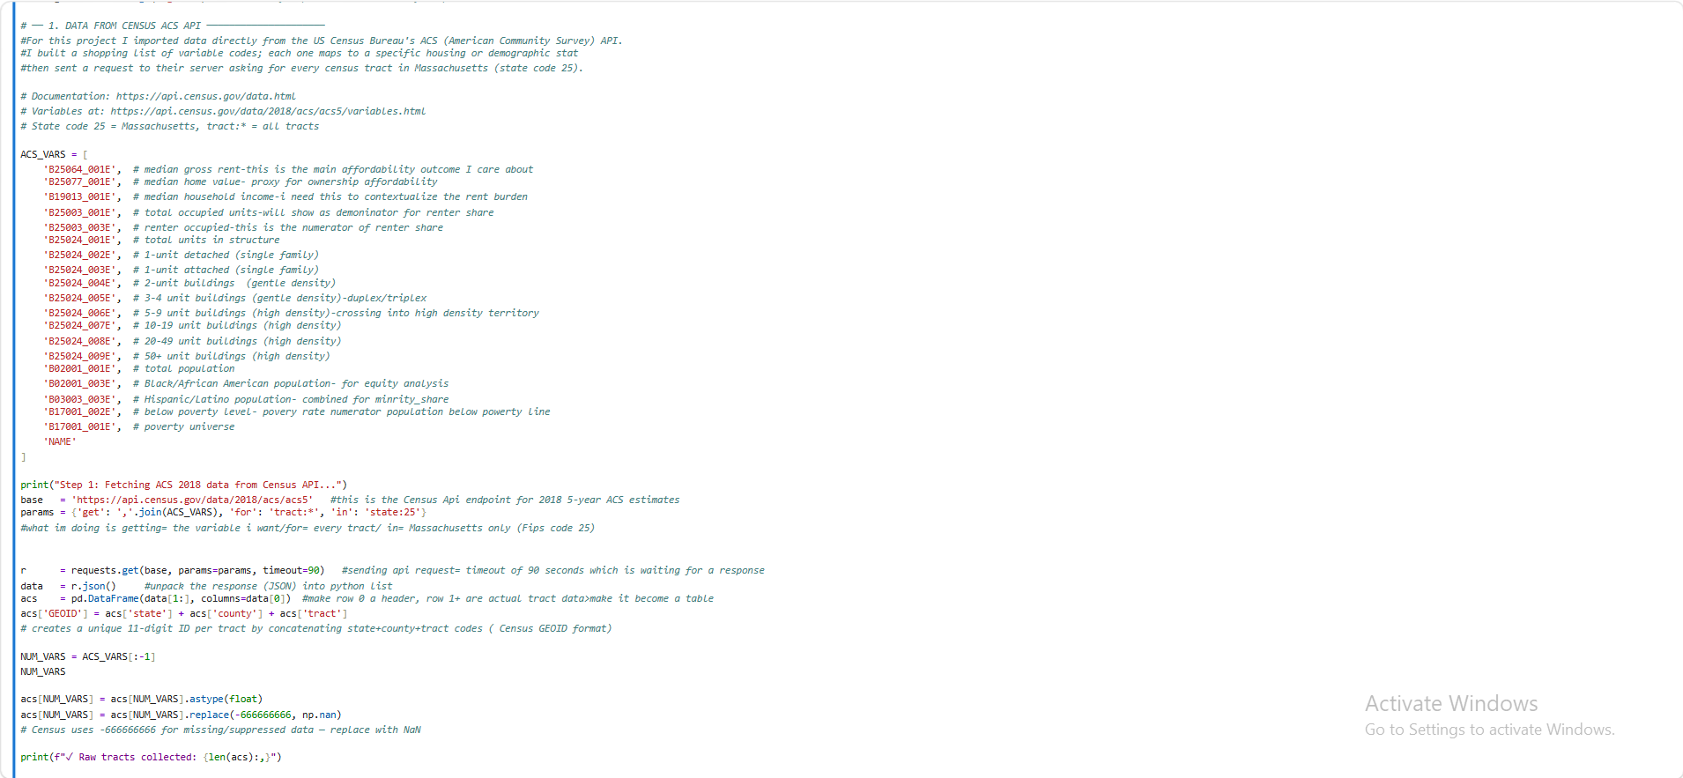
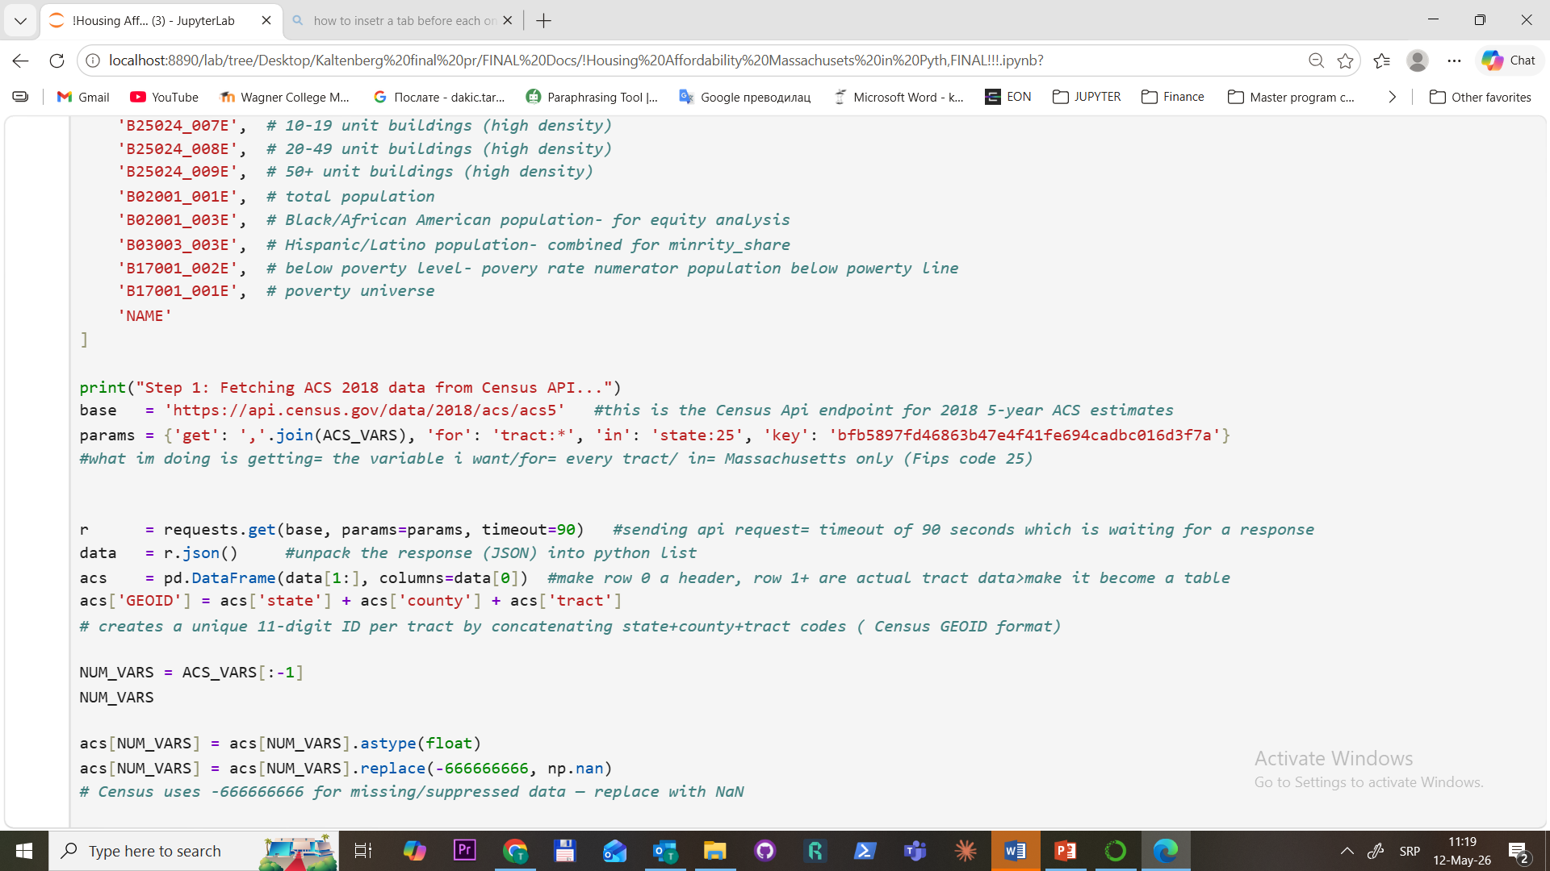
Step 1: Data Collection
For this project i used Census Api data, with link to
All B-code to see what it measures
25 is the Massachusetts Fips code, and * is because I
Want every single tract
ACS_VARS-variable list, 20 census Variable codes requested
***'B25064_001E', # median gross rent (main outcome variable) — what Im trying to explain with zoning. The Census code for median monthly gross rent per tract
Note:Name used foridentification, i.e.,e Census tract 101, Suffolk County, Massachusetts
2
Using Params: (get variable i want/for every tract/ in Massachusetts only)
get-what variables i want (joins all 20 codes into one comma separated string
for: tracts: *-every census tract, * (so meaning all of them)
in: state: 25-Massachusetts only-25 fed Fips Massachusetts
3
r= requests.get – send the request to Census server and store in r
data = r.json – Census server sends my response in JSON format, parses text into python list
Acs= pd.DataFrame –conert the raw list into table (result is clean table 1478 rows)
acs [’GEOID’]- give unique ID number (comb state+county+tract]
NUM_VARS-my variable list removing last name (not number)
Acs[NUM_VARS]-Census sends all values as text- and this converts them into numbers
-Census uses -666666 to mean data missing-swap with NaN
4
5

Slide 7
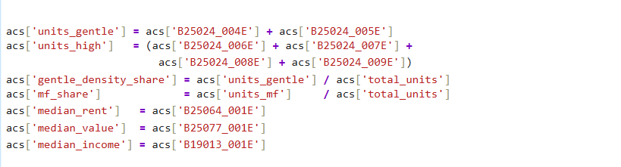
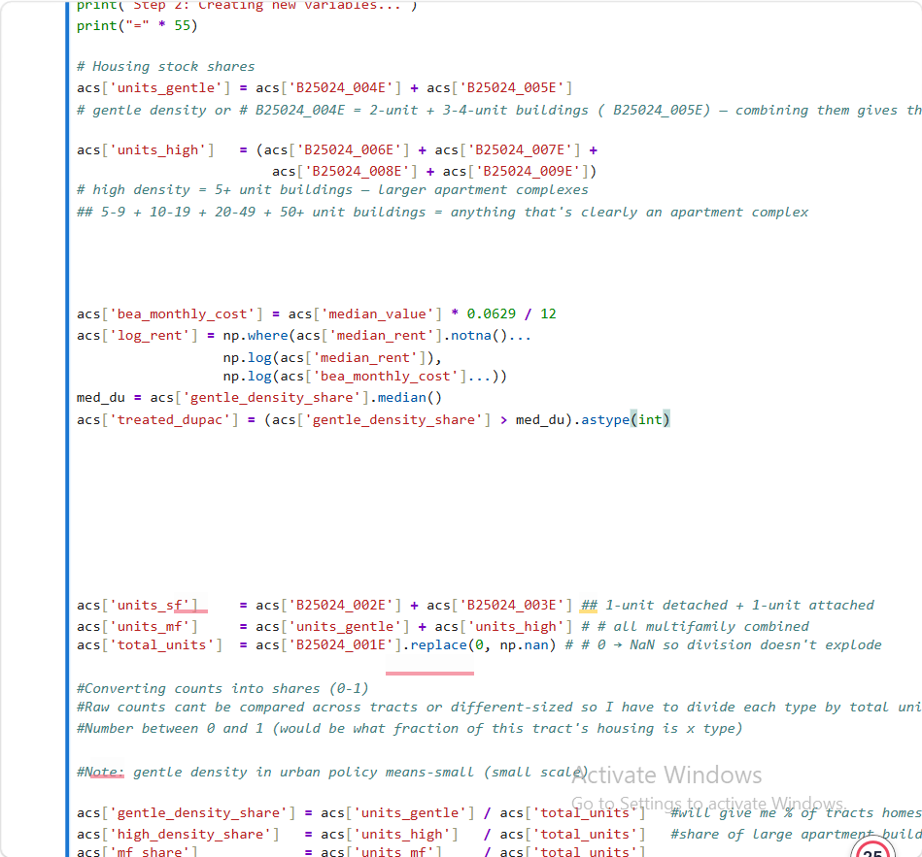
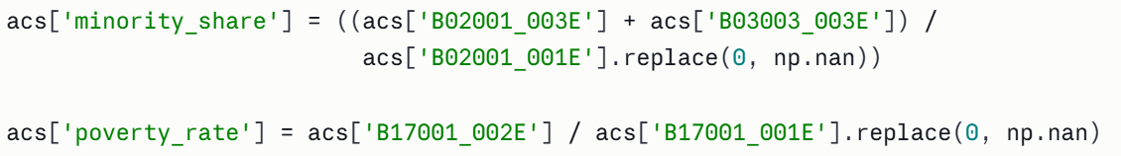
Step 2: Creating new Variables
Units gentle= total count of small multifamily buildings in each tract (2 units +3.4 unit buildings)
Units_heigh= all 5+ unit buildings combined (hig density count)
Gentle density share= making tracts comparable regardless of size ( share between 0 and 1)
Median rent/value and income are just renamed to better names
2
5. bea_monthly cost- (Bureau of Economic Analysis- measures/tracks economic activity, estimating implicit cost at 6.29% of the homes value per year,
Note: Census only collects rent data for renter occupied units-if tract is mostly homeowners (median_rent = NaN) i had 64 tracts like that in suburban and rural areas, instead i used BEAD to find what housing costs in those tracts are
6. np.where-if real rents exists use it if not use BEA estimate (alows me to keep my 1478 tracts for the analysis)
7. med_du- finding middle point of gentle density to find above or medlow median (1 or 0)
8. treated_dupas = 1 for above the median density (treated) 0 for below median density (control)
Holdin income., povery and renter share constant to see if having more missing middle housing actually leads to lower rent.
9.Created povery_rate and minority share-control variables to separate zoning effect from pre-existing neighborhood disadvantages
3
4
5

Slide 8
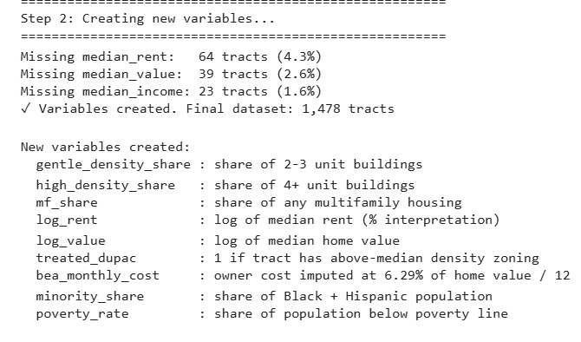
Step 2: Output of new Variables
Missing median rent: of 64 tracts or 4.3% is important number and these are the tracts BEA head to fill in (owner occupied neighborhoods)
Missing median value: 39 tract (2.6%) these are mostly rural tracts where home values were suppressed by Census-too few sales to report reliabily
Missing median income: 23 tracts (1.6%) Very small tracts where income data was supressed for privacy-not enough households to report without identifying people
2
3
4
5

Slide 9
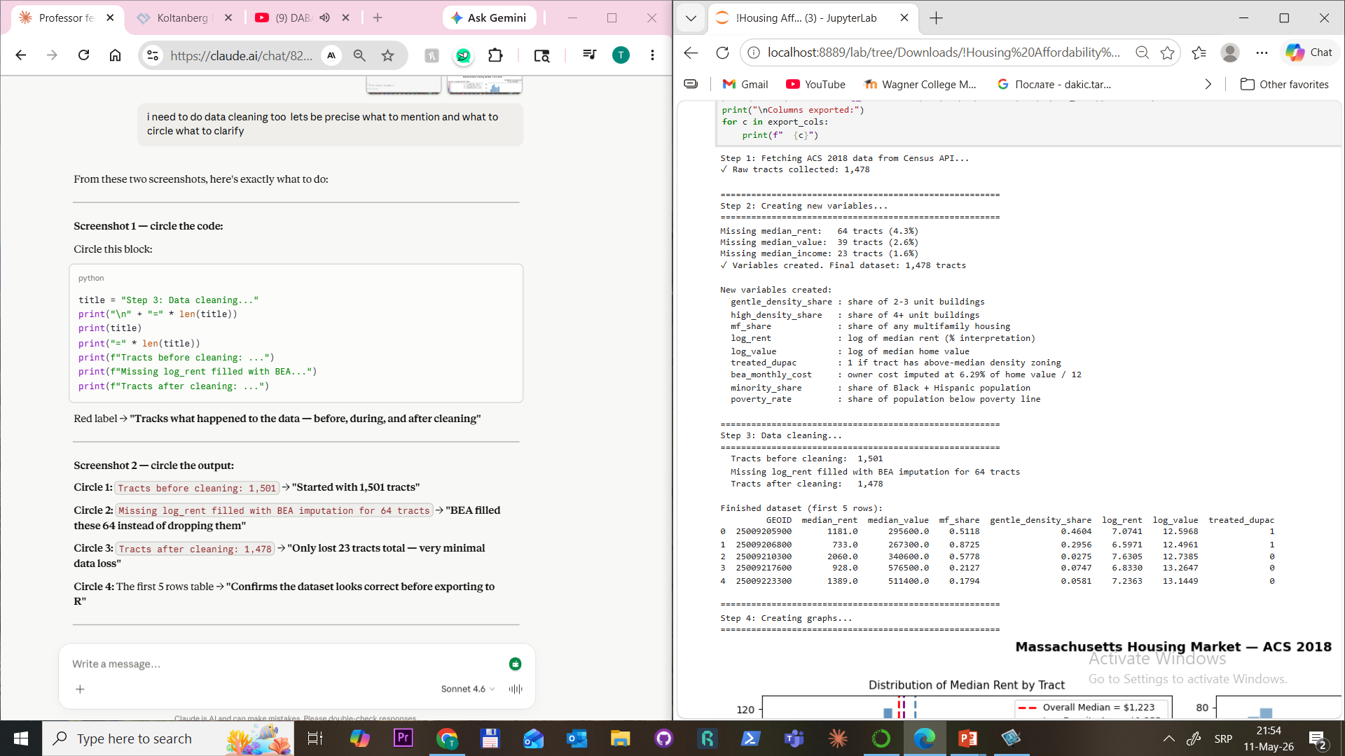
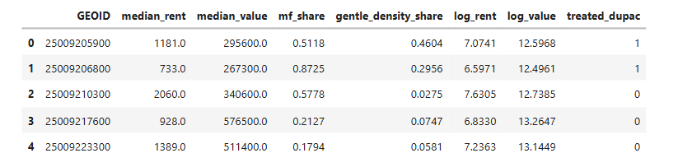
Step 3: Data Cleaning
Before cleaning
Missing log_rent fillied with BEA
2
Data after cleaning
Finished Dataset (first 5 rows)
3
4
5

Slide 10
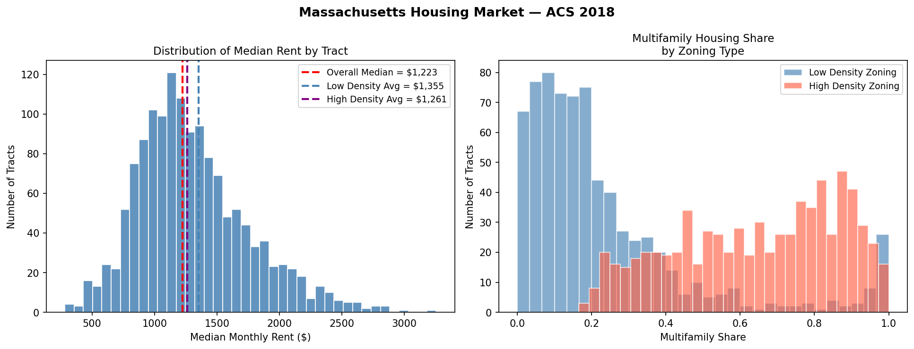
Step 4: Graphs
2
3
4
Graph 1- Distribution of Median Rent by Tract
Shows how median rent is spread across all 1478 tracts
Distribution is right-skewed> most tracts cluster around $1,000-$1,500, but the tail goes to $3,000, meaning there are a few expensive tracts that pull the distribution
Red dashed line= overall median $1,223- half rent below this half above
Blue dashed-Low density averagen (single fam, less multifam) $1,355-tracts with below median missing middle housing actually have HIGHER AVERAGE RENT
Purple dash line-high density average $1261-above median missing housing have LOWER AVERAGE RENT
Graph 2- Multifamily Housing Share by Zoning Type
Overlapping histogram comparing how much multifamily housing exists in low vs high density tracts
Blue = low density tract- heavily concentrated at 0-0.2 shows that most of their housing is single-family
Red/pink = high density tracts-spread further toward 0.8-1.0, most of the housing is multifamily
Overlap: some tracts are mixed
Validates treatment variable - it confirms that treated_dupac = 1 actually captures tracts with more multifamily housing, not just random variation.
5
Notes:
even before the regression you can see in the graph that high density tracts have lower average rent than low density tracts >>>the regression just confirms whether that difference is statistically significant after controlling for income, poverty, and renter share
This is exactly what you would expect if zoning and housing supply affect rent. Single family only neighborhoods restrict housing supply which drives rent up. Areas with more multifamily housing have more supply which keeps rent lower.

Slide 11
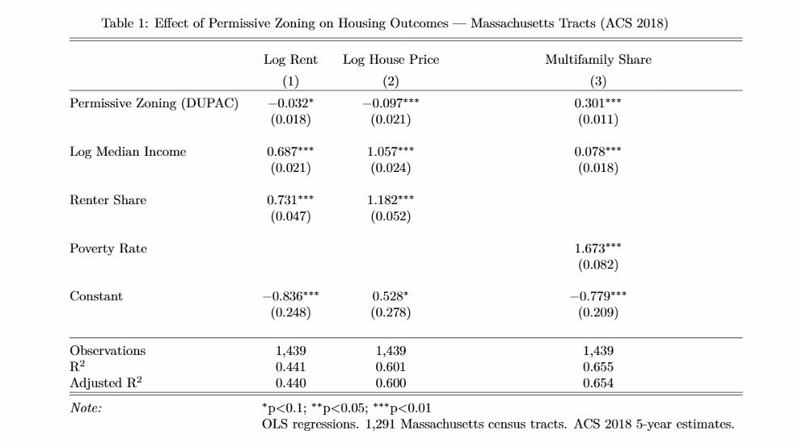
Step 5: Stargazer table
Column 1 Log Rent: -0.032*Tracts with permissive zoning have rent that is 3.2% lower than low density tracts, holding income and renter share constant. The * means statistically significant at p<0.1.
Column 2 — Log House Price: -0.097***Tracts with permissive zoning have home values that are 9.7% lower. Three stars *** means very highly statistically significant at p<0.01
Column 3 — Multifamily Share: 0.301***Tracts with permissive zoning have a 30.1 percentage point higher multifamily share. Three stars again — very significant.
2
3
R² values — 0.441, 0.601, 0.655 — models explain 44%, 60%, and 65% of the variation in rent, home value, and multifamily share.
4
5
Summary: All three tests show the same thing: neighborhoods that allow more types of housing (permissive zoning = allowing duplexes and small apartments, not just single family homes) tend to have lower rents, lower home prices, and more multifamily buildings. All three findings are statistically significant meaning they are not due to chance. The biggest effect is on home values > neighborhoods with more duplexes and small apartments have home values almost 10% (-0.097) lower than similar neighborhoods that only allow single-family homes. Rent is lower because supply is higher due to allowing more types of housing (dupley, triplex, small apartments). Multifamily share is higher by 30.1% because permissive zoning allows more multifamily buildings to be built
Notes:
Home values are lower (-9.7%) because single family homes in exclusive low density neighborhoods carry a premium — people pay more to live in an area zoned for only detached houses. Once you allow multifamily housing that exclusivity premium disappears and values drop.

Slide 12
Key Findings
−3.2%
−9.7%
Lower Rent
Lower Home Values
Permissive zoning tracts have ~3% lower median rent, controlling for income and renter share.
Tracts with gentle density have significantly lower home values (p < 0.001).
+30pp
R²=0.65
More Multifamily
Model Fit
Permissive zoning strongly predicts a 30 percentage-point higher multifamily share.
Income and poverty rate explain substantial variation alongside the zoning treatment.

Slide 13
Regression Models
Model 1
Log Rent
log_rent ~ treated_dupac + log_income + renter_share
Model 2
Log House Price
log_value ~ treated_dupac + log_income + renter_share
Model 3
Multifamily Share
mf_share ~ treated_dupac + log_income + poverty_rate
All models: OLS · 1,439 observations · ACS 2018 5-year estimates
Notes:
Model 1 — Log Rent: log_rent ~ treated_dupac + log_income + renter_share
Testing whether zoning affects rent. treated_dupac is the main variable — does being a high density tract lower rent? log_income and renter_share are controls —hold them constant so you're comparing tracts that are similar in income and renter composition, only differing in zoning. Result: -3.2% lower rent in permissive zoning tracts.
Model 2 — Log House Price: log_value ~ treated_dupac + log_income + renter_share
Same structure but now testing home values instead of rent. Same controls — income and renter share held constant. Result: -9.7% lower home values in permissive zoning tracts. Strongest and most significant finding
Model 3 — Multifamily Share: mf_share ~ treated_dupac + log_income + poverty_rate
Now testing whether permissive zoning actually produces more multifamily housing. Swap renter_share for poverty_rate as the control because poverty is more relevant when explaining housing stock composition. Result: 30.1 percentage points more multifamily housing in permissive zoning tracts.

Slide 14
Limitations
📅 Cross-Sectional Design
🗂️ Indirect Zoning Proxy
Cannot establish causality — unobserved neighborhood characteristics may confound results.
treated_dupac is inferred from built form, not official zoning maps, introducing measurement error.
📐 ACS Measurement Error
💰 Missing Private Data
Sampling variability in small tracts may affect estimates, especially for rare housing types.
CoStar and Warren Group data would enrich analysis but are unavailable without paid subscriptions.

Slide 15
Conclusion
Zoning strongly shapes housing supply across Massachusetts census tracts.
More gentle density zoning → significantly more multifamily housing units.
Areas with more duplexes and small apartments have rent 3.2% lower and home values 9.7% lower than single family dominated neighborhoods.
Wealthier areas and rent-heavy neighborhoods pay more regardless of zoning type.
Results support expanding permissive zoning as a lever for housing affordability reform.
Thank you!

